Slide 1


APPLICATIONS OF GENERATIVE MODELS
TO ENHANCE THE PERFORMANCE OF
COMPLEX PROBABILISTIC SEISMIC MODELS
February, 2021
BY
Martin Nguyen (68623131)
Jian Di (61972461)
Supervisor:
Phil Davies
GNS Science mentors:
Dr. Robert Buxton
Dr. Alexandre Dunant

Slide 2



OUTLINE & ORGANISATION
OUTLINE
ORGANISATION
Project ideas and objectives
Data & preprocessing
Methodology – CTGAN
Methodology – Evaluation
Results – Sub-dataset & Hyperparameters
Results – Correlations – Discrete variables
Results – Correlations & Mappings – Continuous variables
Problems
Discussion and Further research
New Zealand’s leading geoscience and isotope research and consultancy service
GNS Science mentors: Dr. Robert Buxton and Dr. Alexandre Dunant

Slide 3

1. PROJECT IDEAS & OBJECTIVES
Probabilistic Seismic Hazard Analysis
In
Open Quake Engine
CTGAN
Complex
Time-consuming
LESS Complex
LESS Time-consuming
10% - 20%
Synthetic
earthquake dataset
Earthquake dataset
To identify any generative model that could learn the underlying features of the earthquake modelling process.
To evaluate the similarity between the tabular data containing earthquake information and the output generated by the identified model with the tuned hyperparameters.
OBJECTIVES

Slide 4
2. DATA & PREPROCESSING
Containing earthquake information within the Hawke’s Bay area caused by the Hikurangi Subduction Zone
The dataset is public information, but the process of checking the data ethics was still implemented
Variable names | Types | Full dataset (1927173 x 9) | Description
Unnamed: 0 | Positive integer | Renamed to ‘order’ | ID variable for the observations
Event_id | Positive integer | ✓ | ID for the earthquake events
Site_id | Positive float | ✓ | ID for the quake sites
Gmv_PGA | Positive float | ✓ | The shaking value at the site
Vs30 | Positive float | ✓ | Shear-wave velocity from the surface to a depth of 30m
Z2.5 | Positive float | ✓ | Depth at which shear-wave velocity reaches 2.5 km/s
Z1.0 | Positive float | ✓ | Depth at which shear-wave velocity reaches 1.0 km/s
Lon | Positive float | ✓ | Longitude (geometric variable)
Lat | Negative float | ✓ | Latitude (geometric variable)

Slide 5
3. METHODOLOGY – CTGAN
CTGAN MODEL
GENERATOR
DISCRIMINATOR
FAKE / REAL
N (0, 1)
REAL DATASET
SYNTHETIC DATASET
CTGAN model from the ‘ctgan’ package version 0.2.2

Slide 6
4. METHODOLOGY – EVALUATION SYSTEM
Site_id
Correlation on frequencies
(Spearman & Pearson)
Event_id
Individual column
Logistic Detection
Cosine Similarity
Patterns
PGA
Relationships
Mapping
Vs30
Correlation by site_id
(Spearman & Pearson)
Averaged
Averaging
MinMax scaled
Z2.5
Quantile scaled
Z1.0

Slide 7
5. RESULTS – Sub-dataset & Hyperparameters
Variable names | Types | Sub-dataset (145756 x 8)
Event_id | Pos int | ✓
Site_id | Pos int | ✓
Gmv_PGA | Pos float | ✓
Vs30 | Pos float | ✓
Z2.5 | Pos float | ✓
Z1.0 | Pos float | ✓
Lon | Pos float | ✓
Lat | Neg float | ✓
Reduced the full dataset into a sub-dataset by changing the longitude and the latitude
  -39.70 < latitude < -39.40
  176.55 < longitude < 177.90
The sub-dataset was used to generate a synthetic dataset. The similarity evaluation was processed on these two datasets
512
(512, 256, 64)
(512, 256, 64)
1e-4
3000
200
Embedding_dim
Gen_dim
Dis_dim
12scale
Batch_size
Epoch
The size of random sample passed to Generator
The size of Generator network
The size of Discriminator network
The weight decay for the Adam Optimiser
The number of data samples to process in each step
The number of training epochs
Hyperparameters

Slide 8
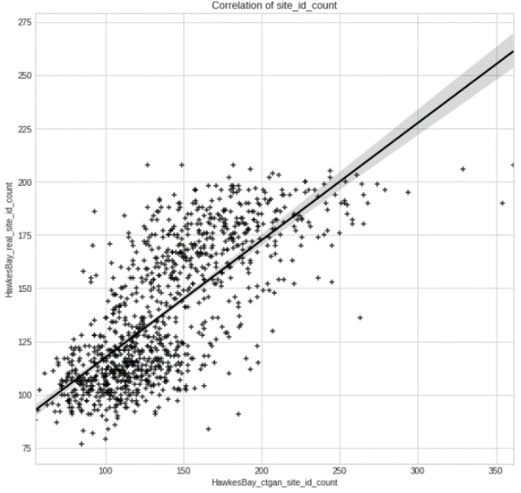
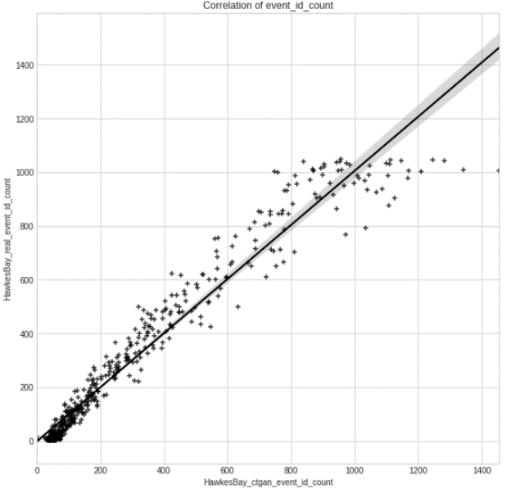
6. RESULTS – Correlations – Discrete variables
ID for geometric points
Same number of the unique site_id
Pearson: 0.735
Spearman: 0.747
Site_id
Key variable for continuous variables
Pearson: 0.975
Spearman: 0.982
Not important
Event_id

Slide 9
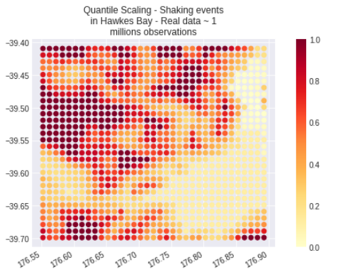
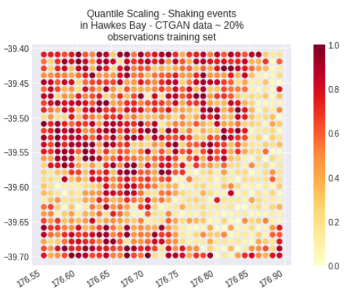
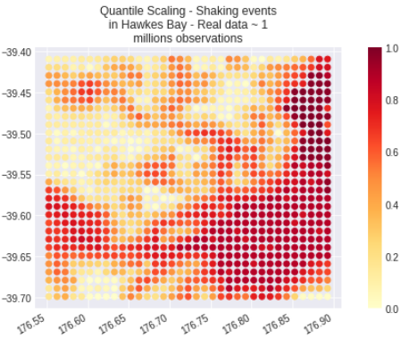
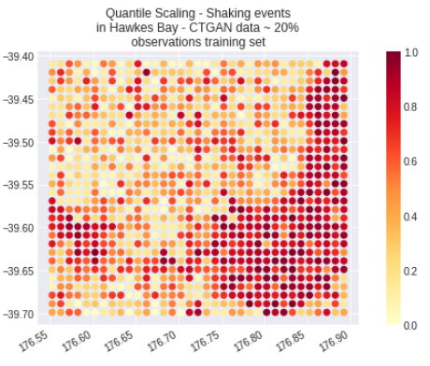
7. RESULTS – Correlations & Mapping – Continuous variables
Vs30
Z2.5
Pearson: 0.712146
Spearman: 0.688790
Pearson: 0.737243
Spearman: 0.657388

Slide 10
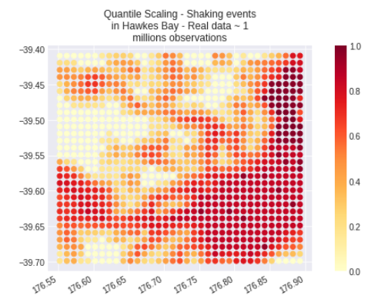

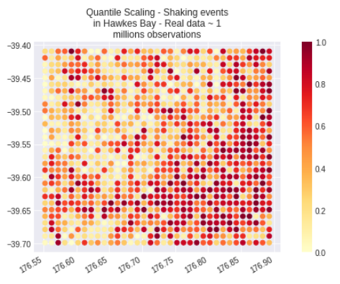
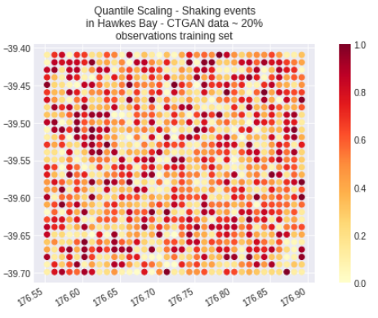
7. RESULTS – Correlations & Mapping – Continuous variables
Z1.0
PGA
Pearson: 0.717711
Spearman: 0.657116
Pearson: -0.029350
Spearman: -0.014253

Slide 11
8. PROBLEMS
Gmv_PGA
0.0025
0.0017
…
OUTLIERS
BIG DIFFERENCES
POWER TRANSFORM
REMOVING OUTLIERS
CTGAN could NOT learn
NEAR
ZERO
VARIANCE
INTERACTION
SCALING

Slide 12
9. DISCUSSIONS & FURTHER RESEARCH
DISCUSSIONS
FURTHER RESEARCH
Objective 1: The CTGAN model from the ‘ctgan’ package version 0.2.2 CAN LEARN the underlying features of the earthquake modelling processes
Objective 2: To evaluate the similarity, an evaluation system was developed:
  Logistic Detection
  Cosine Similarity
  Correlation
  Mapping
Extended research:
  Trying the CTGAN model with other sub-datasets or the whole dataset
  Solutions for PGA
Other research:
  Further applications of generative models in hazard analysis such as flooding and volcanoes

Slide 14
OpenQuake Engine
(PSHA)
Full earthquake data
Subset dataset
Comparison on
Correlations
Variances
Distributions
Boxplots
80 %
20 %
Model selection
Hyperparameters tuning
CTGAN Modelling
Synthetic dataset
Evaluation

Slide 15
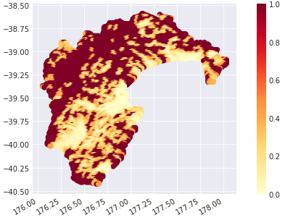
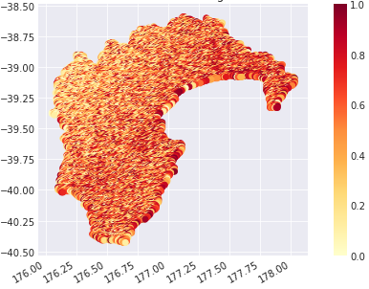
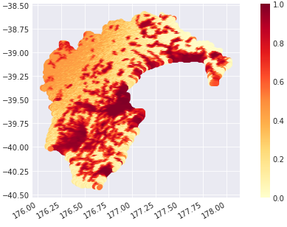
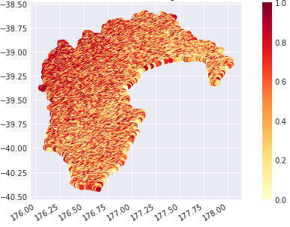
Vs30
Z2.5
Pearson: -0.172997
Spearman: -0.168036
Pearson: -0.138978
Spearman: -0.083244

Slide 16
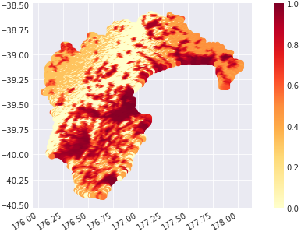
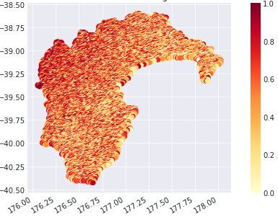
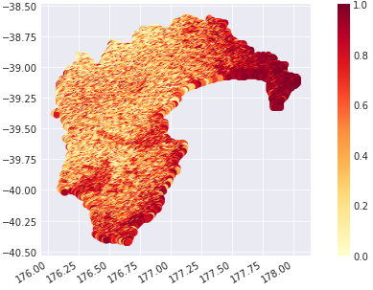
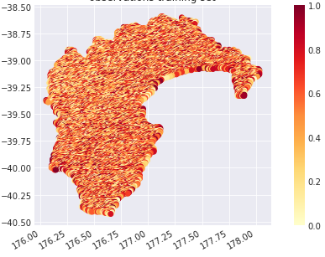
Z1.0
PGA
Pearson: -0.151406
Spearman: -0.171003
Pearson: 0.044864
Spearman: 0.051138

